Slide 1
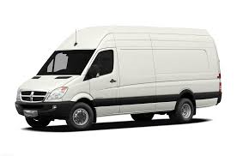
Reliable Delivery; Services
Extreme Expedited; Parcel Delivery
Distance Direct; Long Distance Expedited
Expedited Freight Solutions
Rush Service
2 hour service
Double Rush
1 Hour Service
Triple Rush
30 Minute Service
Distance
Same Day Over 60 miles
Distance Direct
Immediate Pick-Up/Non-Stop Delivery, Over 60 Miles
Deferred
Pick-Up before noon delivery by 5:00pm
Same Day Pick-Up and Delivery Services
Distance Direct – Freight
Lift-Gate Equipped
Cross-Docking and Freight Storage Capabilities

Slide 2
Reliable Delivery; Current Network
Midland
Flint
Grand Rapids
Lansing
Detroit
Kalamazoo
Ann Arbor
Toledo

Slide 3
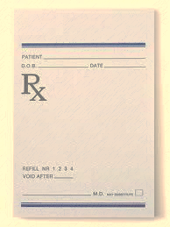
Reliable Delivery Prescription For Trained Professionals
Signed Business Associate Agreement for HIPPA Compliance
TSA Compliant
Haz Mat Awareness Training
IATA Dangerous Goods Training
Specimen Handling Certification
Blood borne Pathogen Certification
Clean Motor Vehicle Report
Drug Screening
Clear Background Check
CPR Training

Slide 4
Reliable Delivery; Positive “Change”
Driver Efficiency
Route drivers are paid by delivery/pick-up stop NOT per hour
Route Coverage
Each Reliable Delivery route driver has route coverage of 2-3 drivers deep
Route Redundancies
Our Transition Process has allowed Reliable Delivery to reduce route redundancies In over 60% of transitioned clients
Quick Transition In Route Changes
Route changes or new route inclusions can be transitioned within 24 Hours

Slide 5
Reliable Delivery Company Owned vs. Outsourced Solution
Company Cost
Outsourced Solution

Slide 6
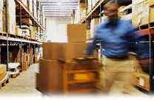
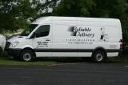
Reliable Delivery
“When Getting it There Becomes the Priority!”
Tony Darin
Sr. Vice President of Sales & Marketing
tdarin@reliabledelivery.com
(734) 756-7828

